Slide 1
Visual Grouping: Contours and Regions in Natural Images
Jitendra Malik
University of California at Berkeley

Slide 2
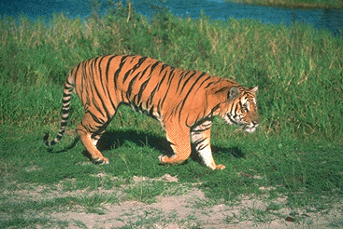
From Pixels to Perception
Water
Grass
outdoor
wildlife
Tiger
Sand
back
Tiger
head
eye
tail
legs
mouth
shadow

Slide 3
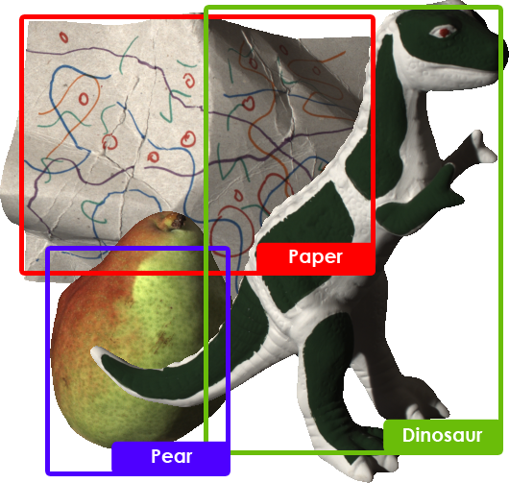

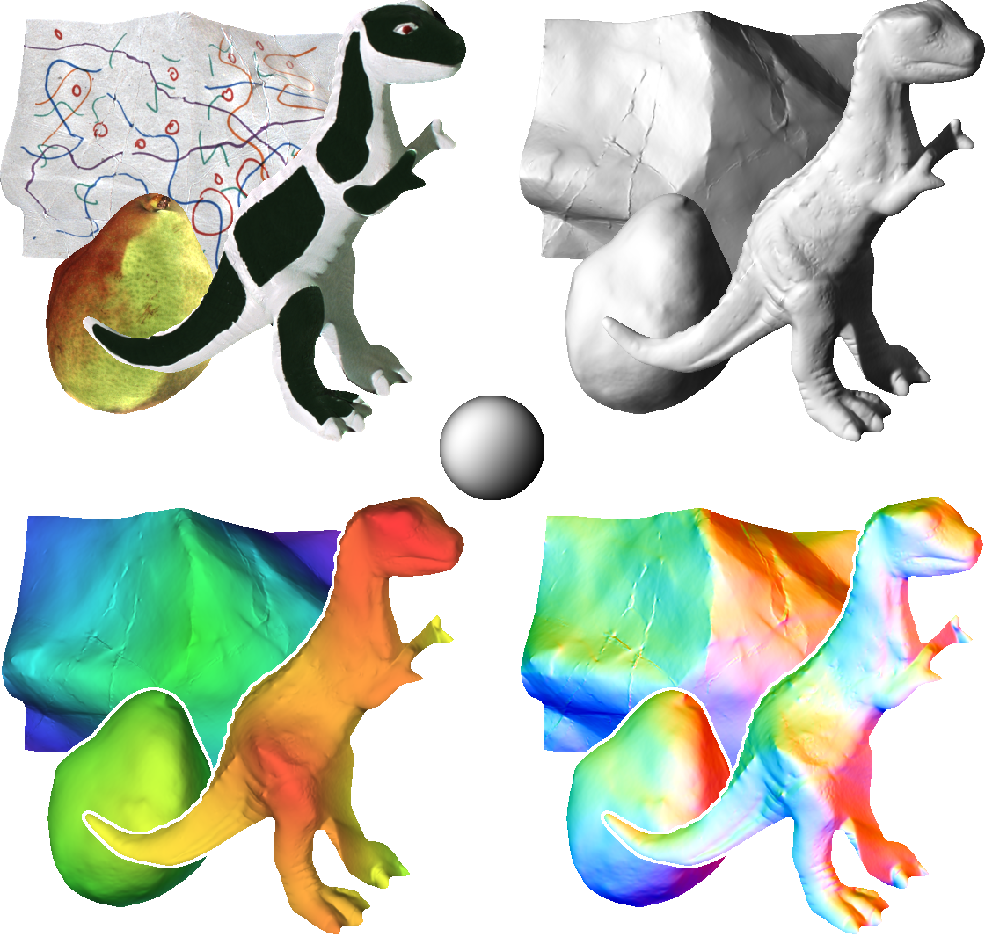
Recognition, Reconstruction & Reorganization
Recognition
Reorganization
Reconstruction

Slide 4
The Three R’s of Vision
Recognition
Reconstruction
Reorganization
Each of the 6 directed arcs in this diagram is a useful direction of information flow

Slide 5
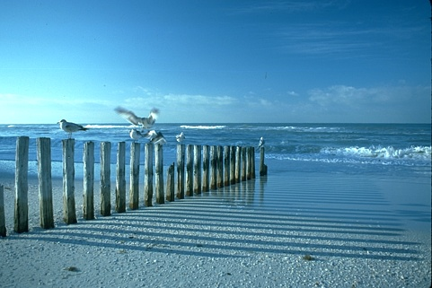
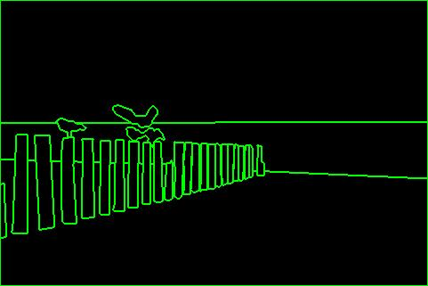
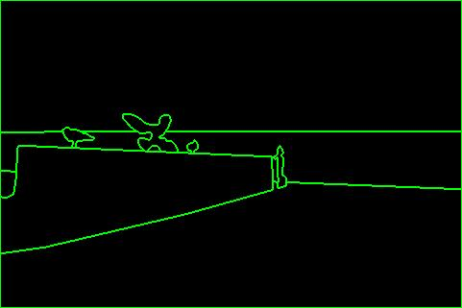
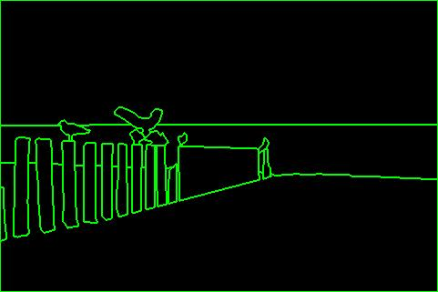
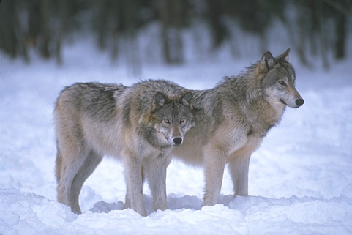
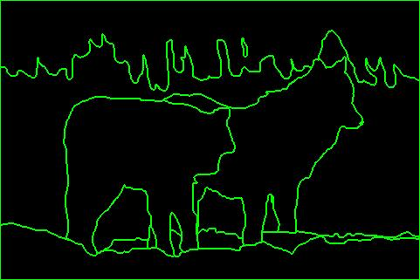
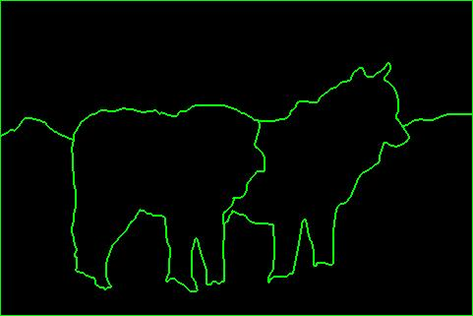
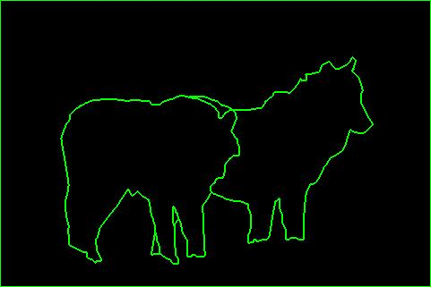
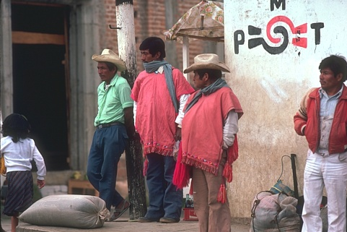
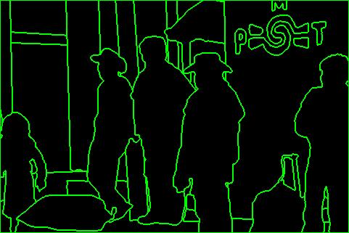
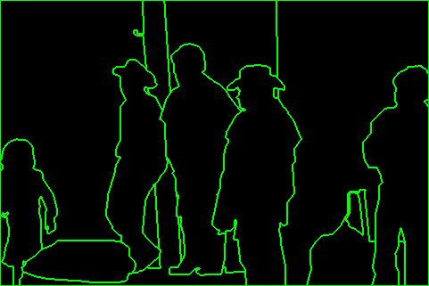
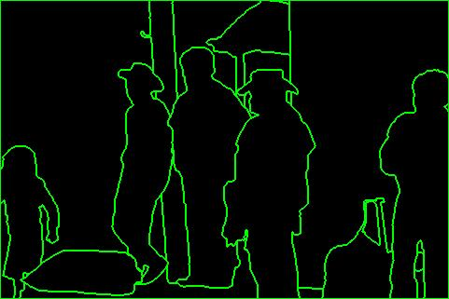

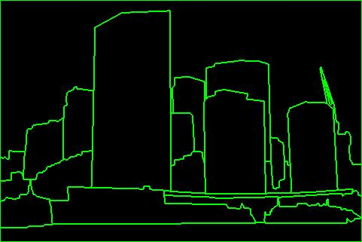
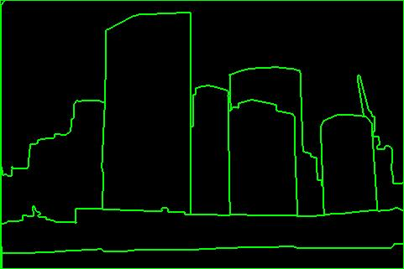
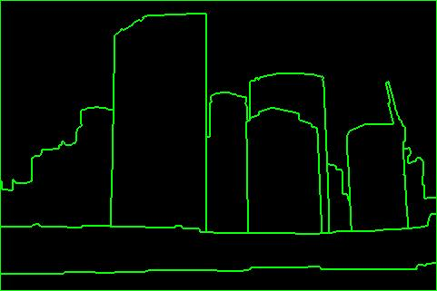
Berkeley Segmentation DataSet [BSDS]
D. Martin, C. Fowlkes, D. Tal, J. Malik. "A Database of Human Segmented Natural Images and its Application to Evaluating Segmentation Algorithms and Measuring Ecological Statistics", ICCV, 2001

Slide 6
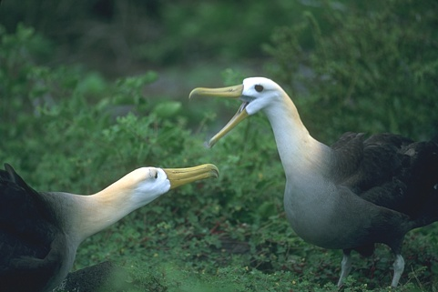
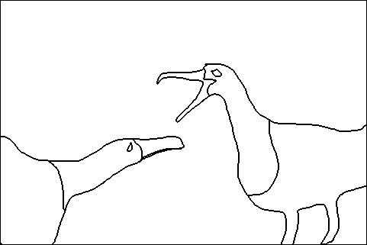
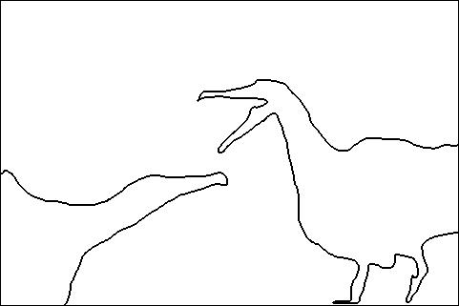
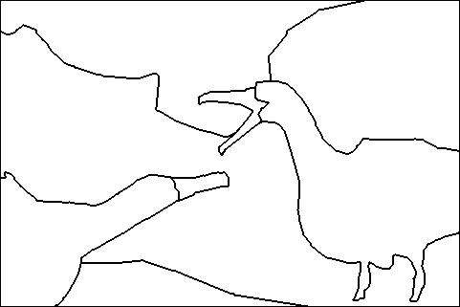
Consistency
A
Perceptual organization forms a tree:
Image
BG
L-bird
R-bird
B
C
grass
bush
far
beak
body
beak
body
eye
head
eye
head
Two segmentations are
consistent when they can be
explained by the same
segmentation tree (i.e. they
could be derived from a single
perceptual organization).
A,C are refinements of B
A,C are mutual refinements
A,B,C represent the same percept
Attention accounts for differences

Slide 7
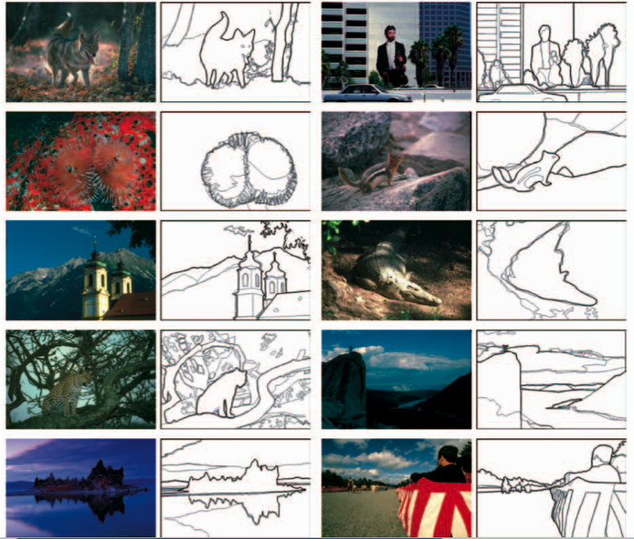

Slide 8
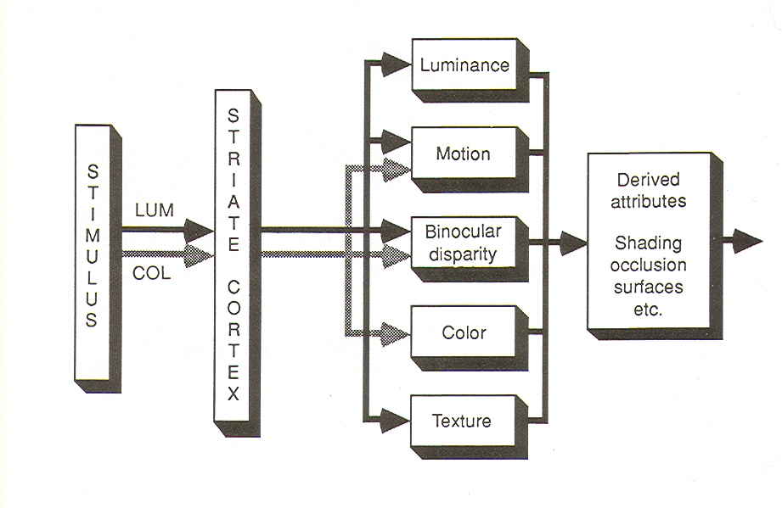
Contours can be defined by any of a number of cues (P. Cavanagh)

Slide 9
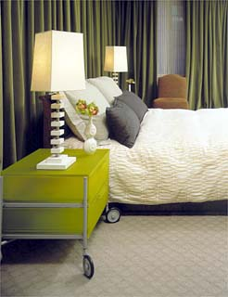
Boundaries of image regions defined by a number of cues
Brightness
Color
Texture
Motion (in video)
Binocular Diparity (if available)
Familiar objects

Slide 10
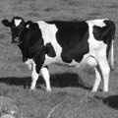
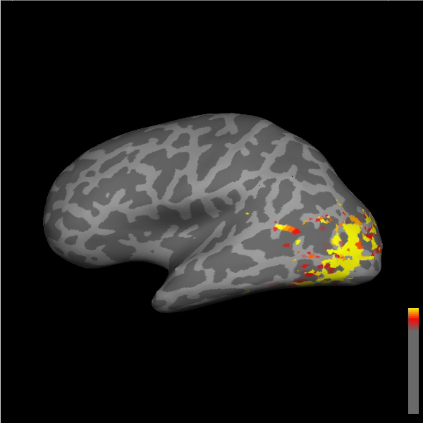
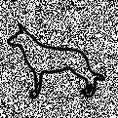

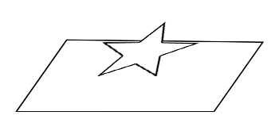
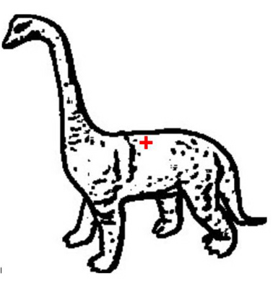
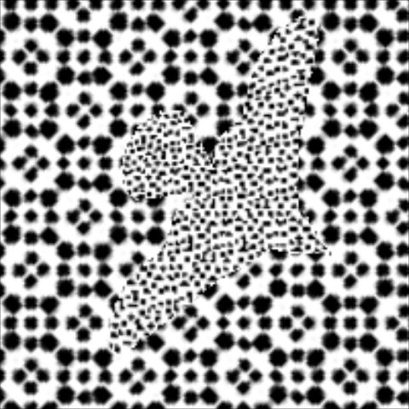
Cue-Invariant Representations
Gray level photographs
Objects from motion
Objects from luminance
Objects from disparity
Line drawings
Objects from texture
Grill-Spector et al. , Neuron 1998

Slide 11
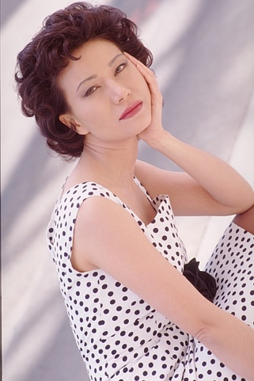
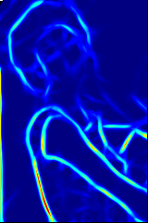
Martin, Fowlkes, Malik PAMI 04
P_{b}
Image
Boundary Cues
Cue Combination
Brightness
Model
Color
Texture
Challenges: texture cue, cue combination
Goal: learn the posterior probability of a boundary P_{b}(x,y,θ) from local information only

Slide 12
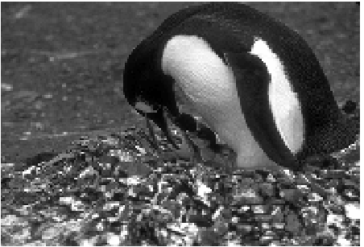
Oriented Feature Gradient

Slide 13
Visual Texture
Jitendra Malik
University of California, Berkeley

Slide 14
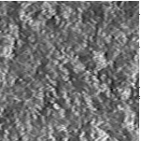
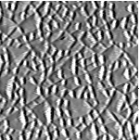
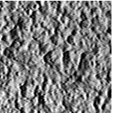
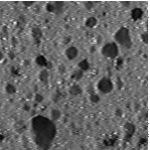
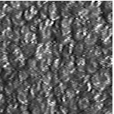
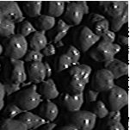
Example Natural Materials
Terrycloth
Rough Plastic
Plaster-b
Sponge
Rug-a
Painted Spheres
Columbia-Utrecht Database (http://www.cs.columbia.edu/CAVE)

Slide 15
Example Natural Materials
Terrycloth
Rough Plastic
Plaster-b
Sponge
Rug-a
Painted Spheres
Columbia-Utrecht Database (http://www.cs.columbia.edu/CAVE)

Slide 16
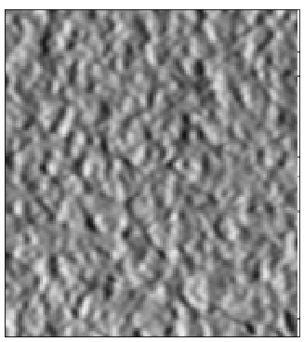
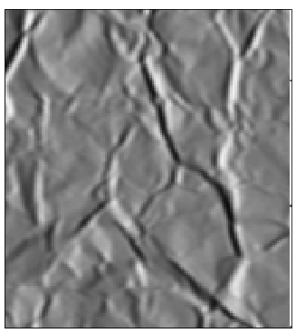
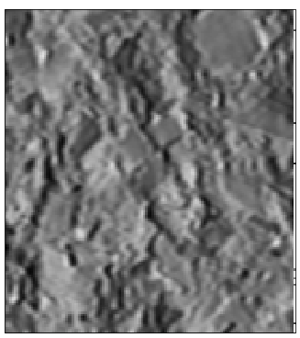
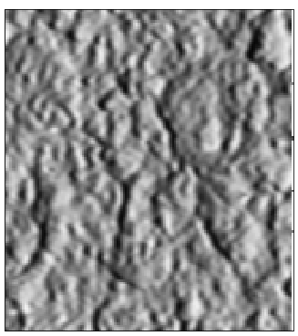
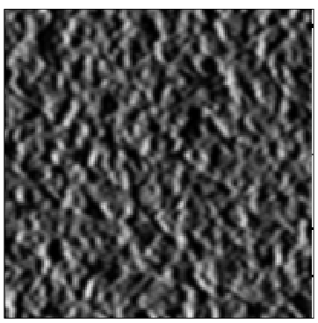
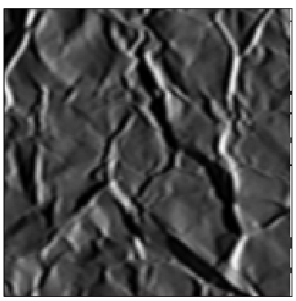
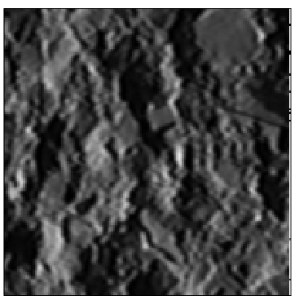
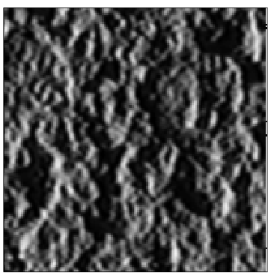
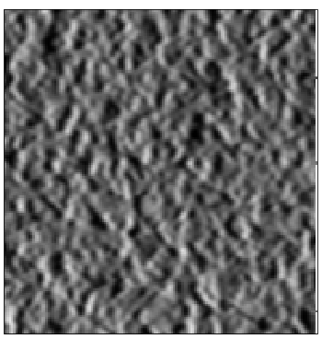
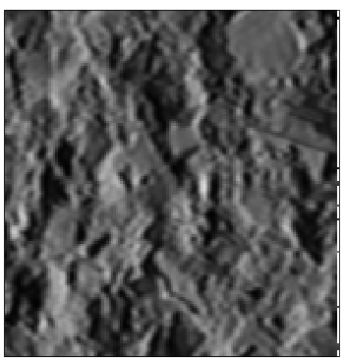

Materials under different illumination and viewing directions
Different
illumination
and viewing
directions
Plaster-a
Crumpled
Paper
Concrete
Plaster-b
(zoomed)

Slide 17


Slide 18
Julesz’s texton theory
Human Vision operates in two distinct modes
Pre-attentive vision - parallel, instantaneous, without scrutiny, independent of the number of patterns
Attentive vision - serial search by focal attention in 50 ms steps limited to a small aperture as in form recognition
Textons are
Elongated blobs - e.g. rectangles, ellipses, line segments with specific orientations, widths and lengths
Terminators - ends of line segments
Crossings of line segments

Slide 19

Orientation is a texton

Slide 20

Terminators are textons

Slide 21


Slide 22


Slide 23


Slide 24


Slide 25


Slide 26


Slide 27


Slide 28


Slide 29


Slide 30


Slide 31


Slide 32
Texture Recognition
Felt?
Polyester?
Terrycloth?
Rough Plaster?
Leather?
Plaster?
Concrete?
Crumpled Paper?
Sponge?
Limestone?
Brick?
?
?

Slide 33

2D Textons
Goal: find canonical local features in a texture;
1) Filter image with linear filters:
2) Vector quantization (k-means) on filter outputs; 3) Quantization centers are the textons.
Spatial distribution of textons defines the texture;

Slide 34


2D Textons (cont’d)

Slide 35

Texton Labeling
Each pixel labeled to texton i (1 to K) which is most similar in appearance;
Similarity measured by the Euclidean distance between the filter responses;

Slide 36
Material Representation
Each material is now represented as a spatial arrangement of symbols from the texton vocabulary;
Recognition --- ignore spatial arrangement, use histogram (K=100);

Slide 37




Histogram Models for Recognition (Leung & Malik, 1999)
Rough Plastic
Pebbles
Plaster-b
Terrycloth

Slide 38
Similarity of materials
Similarity between histograms measured using chi-square difference:

Slide 39





Similarity Matrix
Plaster-a
Plaster-b
Aluminum
Foil
Cork

Slide 40
Oriented Feature Gradient

Slide 41

Individual Features
1976 CIE L*a*b* colorspace
Brightness Gradient BG(x,y,r,θ)
Difference of L* distributions
Color Gradient CG(x,y,r,θ)
Difference of a*b* distributions
Texture Gradient TG(x,y,r,θ)
Difference of distributions of V1-like filter responses
r
(x,y)
θ
These are combined using logistic regression

Slide 42







Filter Outputs

Slide 43



Texture gradient = Chi square distance between texton histograms in half disks across edge
i
j
0.1
k
0.8
Notes:
Compare using chi-square stat.

Slide 44

Various Cue Combinations
(Martin, Fowlkes, Malik, 2004)

Slide 45
Exploiting global constraints: Image Segmentation as Graph Partitioning
Build a weighted graph G=(V,E) from image
V: image pixels
E: connections between pairs of nearby pixels
Partition graph so that similarity within group is large and similarity between groups is small -- Normalized Cuts [Shi & Malik 97]

Slide 46

Wij small when intervening contour strong, small when weak.. Cij = max Pb(x,y) for (x,y) on line segment ij; Wij = exp ( - Cij / σ 
Notes:
So what are our similarity cues going to be?
For a pair of points i and j, what can we measure about the image that will tell us whether they belong to the same group?
We can start by looking in a small neighborhood around each point and comparing them. Do they have similar
Color, intensity …texture? Of course this isn’t really enough since if I choose points from both these elephants, they
Will have the same local appearance. <click>

Slide 47


How to partition a graph
We can find the minimum cut efficiently, but this tends to break the graph into isolated little pieces

Slide 48


Normalized Cut is a better measure ..
We normalize by the total volume of connections

Slide 49


Solving the Normalized Cut problem
Exact discrete solution to Ncut is NP-hard even on regular grid [Papadimitriou’97]
We first transform to
Drawing on spectral graph theory, good approximation can be obtained by solving a generalized eigenvalue problem.

Slide 50


Normalized Cuts as a Spring-Mass system
Each pixel is a point mass; each connection is a spring:
Fundamental modes are generalized eigenvectors of
(D - W) y = λDy

Slide 51




Eigenvectors carry contour information

Slide 52


Slide 53


Slide 54

Comparison to other approaches (2009)

Slide 55













Slide 56













Slide 57

















Slide 58

















Slide 59

















Slide 60

















Slide 61


Slide 62


Slide 63


Slide 64


Slide 65


Slide 66

Martin, Fowlkes, Malik PAMI 04
Image
Boundary Cues
Brightness
Color
Texture
We trained a detector that combine multiple cues to find the posterior probability of a boundary/edge P_{b}(x,y,θ). After that we used Normalized Cuts (Shi & Malik) to find regions.

Slide 67

Multiscale Combinatorial Regions Arbelaez, Pont-Tuset, Barron, Marques & Malik, CVPR 2014

Slide 68


Slide 69

Examples

Slide 70


Slide 71


